Slide 1
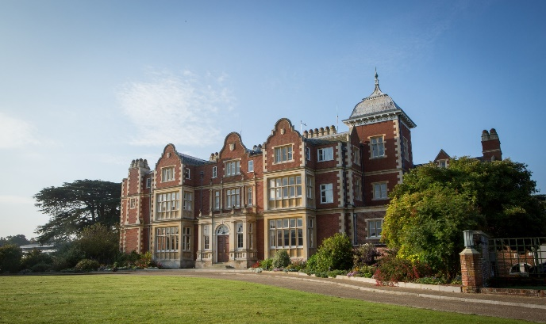
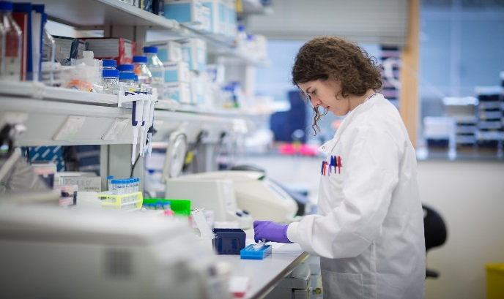
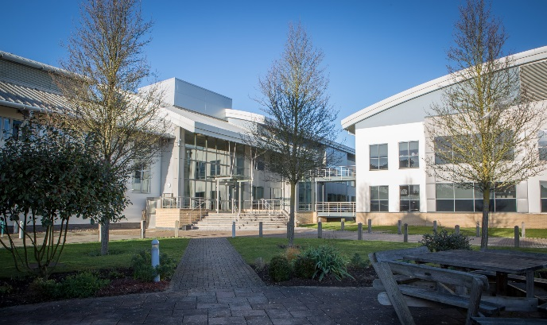
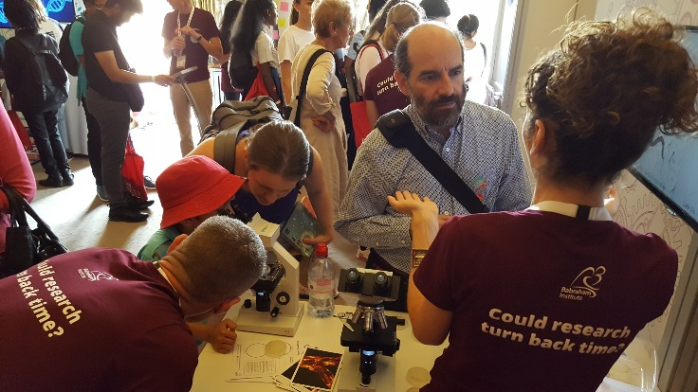
The Epigenetic Clock
@babrahaminst

Slide 2
Learning Outcomes
All students will: | Explain the differences between biological and chronological age.
Most students will: | Describe how lifestyle factors can influence the ageing speed differently.
Some students will: | Explain how epigenetics is linked to biological age
Key word/s | Epigenetics, ageing, healthy ageing, life style

Slide 3
Epigenetics
DNA is the same in each cell, but they all work differently → epigenetics
Epigenetic marks switch genes on and off to control cell function
Chemical marks include DNA methylation through the addition of a methyl (CH3) molecule
Notes:
! Mike, could you please copy- paste the images from the indesign files?!
See fact sheet for more information

Slide 4
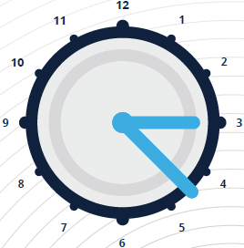
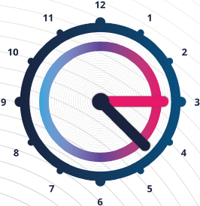
Chronological Age vs Biological Age
We all have two different ages
Chronological Age
Time Since Birth
Ticks away with the course of time and is based on the day you were born
Biological Age
Wear & Tear
Measures the extent of ‘wear and tear’ in your body as you age.
Notes:
! Mike, could you please copy- paste the images from the indesign files?!
See fact sheet for more information

Slide 5
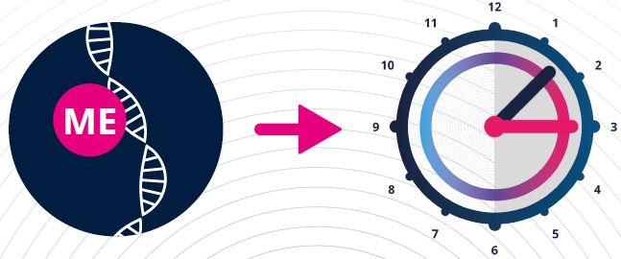
The Epigenetic Clock
The Epigenetic Clock is a computer model that estimates a mouse’s biological age
It looks at changes in DNA methylation at 329 specific places, out of a possible 23 million, where DNA methylation changes can occur
The Epigenetic Clock allows researchers to test the effect of lifestyle factors on ageing in mice
Notes:
! Mike, could you please copy- paste the images from the indesign files?!
See fact sheet for more information

Slide 6
What can influence ageing in mice?
DIET FAT CONTENT
CALORIE INTAKE
RESPONSE TO GROWTH HORMONE
Notes:
! Mike, could you please copy- paste the images from the indesign files?!
See fact sheet for more information

Slide 7
Choose your mouse
DIET FAT CONTENT
CALORIE INTAKE
RESPONSE TO GROWTH HORMONE
Notes:
! Mike, could you please copy- paste the images from the indesign files?! Movies to be recorded and uploaded
See fact sheet for more information

Slide 8
Answers
 | Mouse 1 | Mouse 2
Blue card | 6.5 months | 6 months
Orange card | 6 months | 3 months
Purple card | 6 months | 4 months
Notes:
See fact sheet for more information
Researchers hope to understand the mechanisms of this process and in the future be able to slow down the ageing process in humans as well, without them having to restrict a large percentage of their diets.

Slide 9
Recap
What is the difference between chronological and biological age?
What is the relation between epigenetics and biological age?
How do “diet fat content”, “caloric intake” and “response to growth hormone” influence the ageing speed?

Slide 10
More information on the Epigenetic Clock
The Reik group at the Babraham Institute discovered the Epigenetic clock in mice and developed the model.
More information can be found here: https://www.babraham.ac.uk/our-research/epigenetics/wolf-reik

