Slide 1
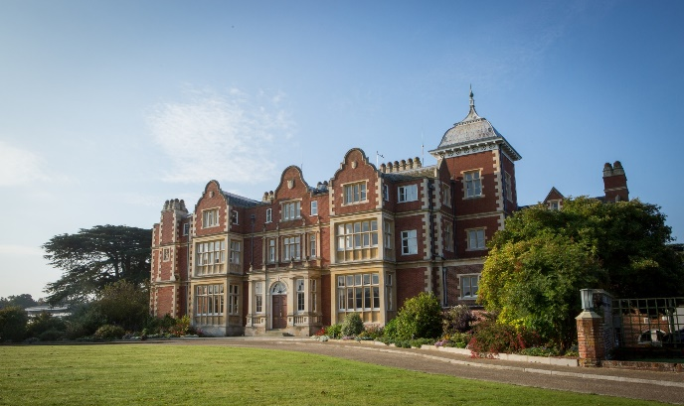
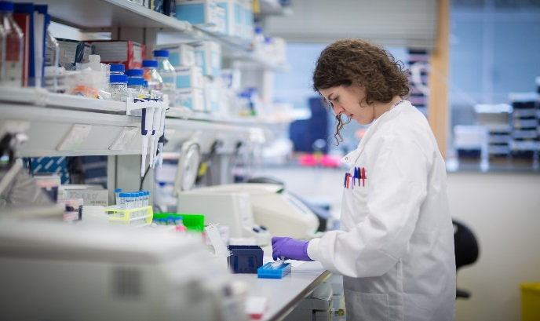
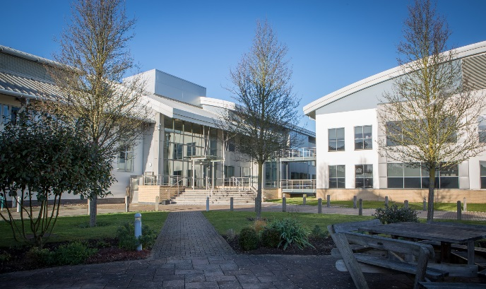
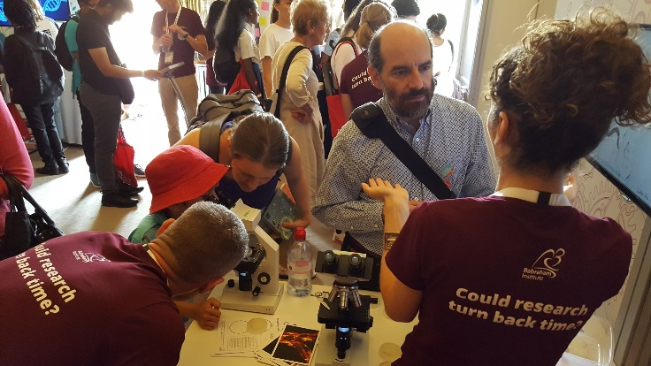
Exploring Epigenetics
@babrahaminst

Slide 2
Learning Outcomes
All students will: | Be able to explain the purpose of epigenetics
Most students will: | Explain histone modifications and how they regulate gene expression
Some students will: | Develop a teaching resource to explain epigenetics to a non-science audience
Key word/s | Epigenetics, histones, nucleosome, DNA, methylation

Slide 3
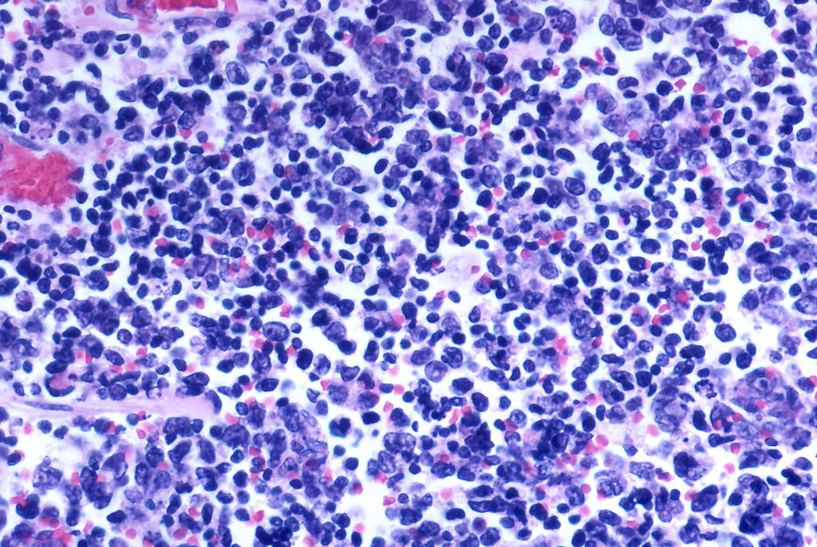
Starter (1)
Roughly how many cells does your body have?
How many different cell types are there?
Notes:
50 trillion cells
200 different cell types
CC image -https://www.flickr.com/photos/pulmonary_pathology/5018644792

Slide 4
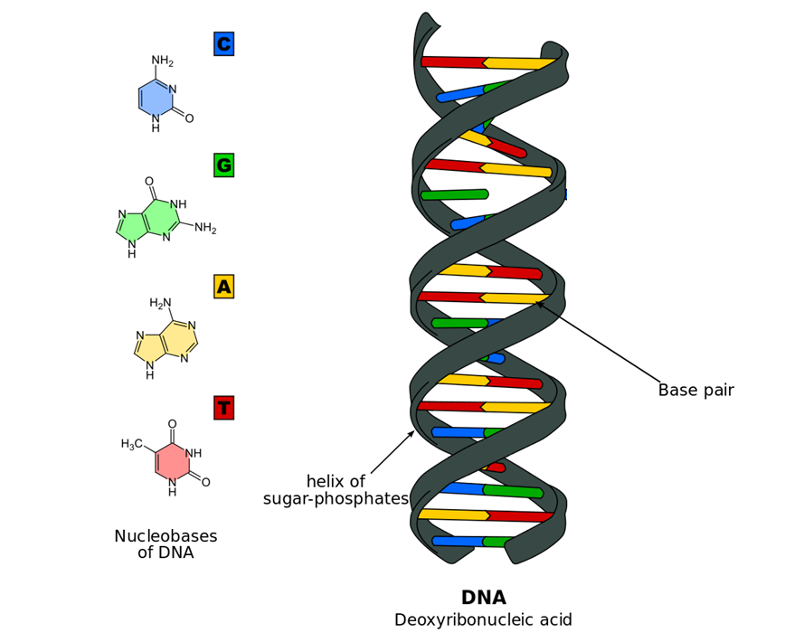
Starter (2)
What are the names of the four nucleotide bases that make up DNA?
1
2
3
4
Notes:
Adenine (A), Cytosine (C), Guanine (G), Thymine (T)
CC image - https://se.wikipedia.org/wiki/Fiila:Dna-base-flipping.svg

Slide 5
Starter (3)
How do epigenetics allow different cell types to express different genes?
Notes:
Epigenetics add marks to help decide whether a portion of DNA (gene) is switched on (expressed) or off (silenced)
CC image - https://commons.wikimedia.org/wiki/File:422_Feature_Stem_Cell_new.png

Slide 6
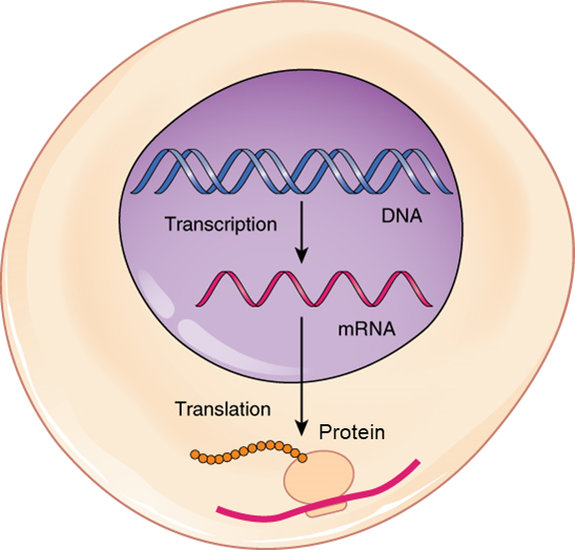
Starter (4)
What is the process of making an RNA copy of an active gene called?
What is the word that describes how messenger RNA leads to protein synthesis?
Notes:
Transcription
Translation
CC image - https://commons.wikimedia.org/wiki/File:0328_Transcription-translation_Summary.jpg

Slide 7
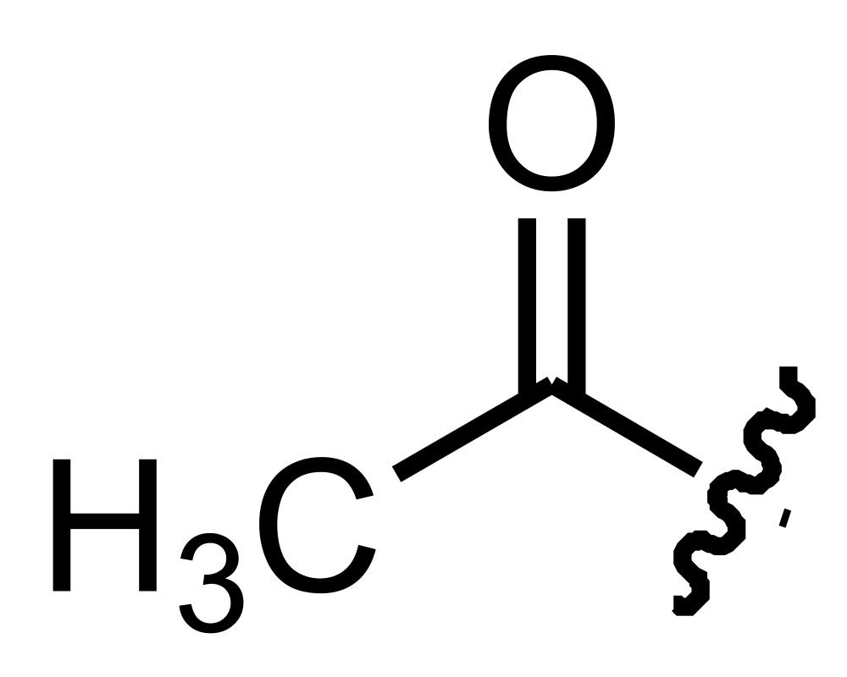
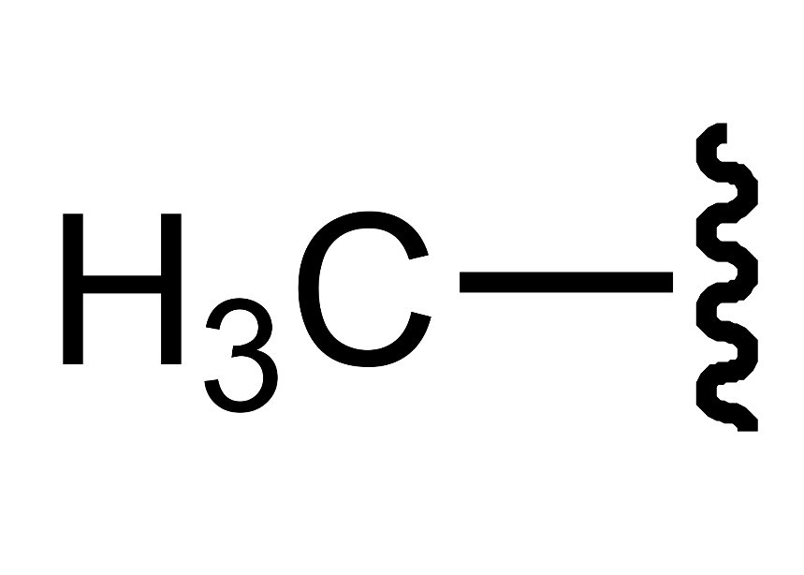
Starter (5)
Name two chemical groups that form epigenetics marks on DNA
Methyl group (methylation)
Acetyl group (acetylation)
Notes:
Methyl (methylation is when a methyl group is added to alter gene expression)
Acetyl (Acetylation is when an acetyl group is added to alter gene expression)
CC images:
Methyl group - https://commons.wikimedia.org/wiki/File:Methyl_group.svg
Acetyl group - https://commons.wikimedia.org/wiki/File:Acetyl_group.svg

Slide 8
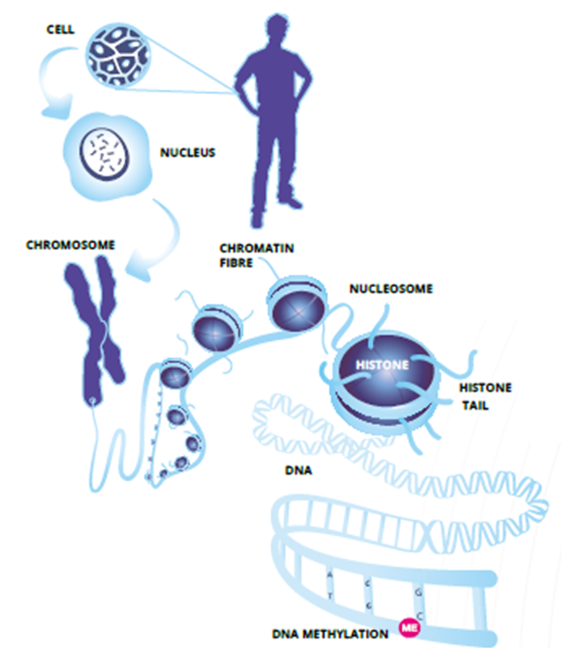
Epigenetics
All of our cells in our body has identical DNA
But we have 200 types of cells that function very differently
Epigenetics is the way that genes are regulated to determine what is switched on or off
This allows each part of your body to do different jobs
Notes:
See fact sheet for more information

Slide 9
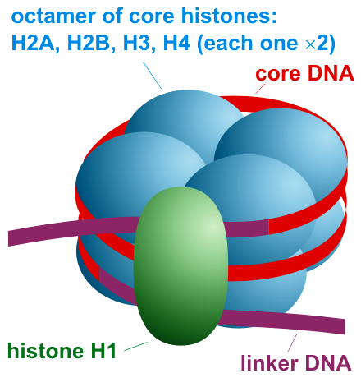
The nucleosome
DNA wraps around histones to make the nucleosome, which is where epigenetic alterations occur
Each nucleosome is made up of 8 proteins called histones
The tails of histones are where epigenetic changes occur
Chemical marks that cause epigenetic changes include DNA methylation & acetylation
The nucleosome
Notes:
See fact sheet for more information
CC image of nucleosome - https://commons.wikimedia.org/wiki/File:Nucleosome_organization.png

Slide 10
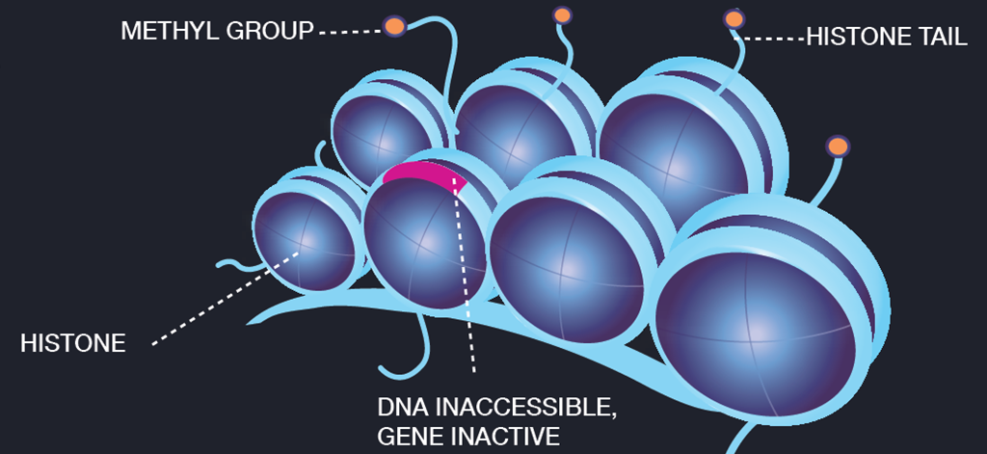
Methylation
Methylation occurs through the addition of a methyl (CH3) molecule and packs the nucleosomes tightly
If the nucleosomes are packed together tightly, genes are not accessible, and so are switched off
Notes:
See fact sheet for more information

Slide 11
Acetylation
DNA acetylation through the addition of an acetyl (CH₃CO) molecule and packs the nucleosomes loosely
Nucleosomes loosely packed together have accessible genes that are switched on
Notes:
See fact sheet for more information

Slide 12
Understanding epigenetics for research
Epigenetic marks are changed in:
Different cell types
Disease states
Response to physiological stimuli
Over time with age
Researchers believe that understanding epigenetics can help with the treatment of disease

Slide 13
Explaining epigenetics to a non-scientist audience
Being able to explain scientific concepts to non-specialist audiences is an essential skill.
How could we describe epigenetics?
‘A book with chapters that are locked until required’
‘A wardrobe that only allows a few clothes to be taken out at a time’
‘A road system with some routes closed off and others open for traffic’
A physical model of a DNA helix including epigenetic marks could be a better way of explaining the concepts.

Slide 14
Activity: Build an epigenetics model!
Your challenge: Create a resource to explain epigenetics to a non-science audience
How will you show how epigenetic marks affect the function of the DNA without changing its sequence?
Will it be interactive?
A physical model?

Slide 15
Recap
What is the purpose of epigenetics?
In what circumstances do epigenetic marks change?
Why is it important that researchers understand epigenetics?
What are two examples of histone modifications?
What effects do these modifications have to gene expression?

