Slide 1
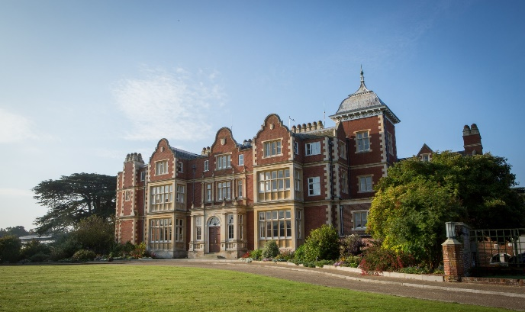
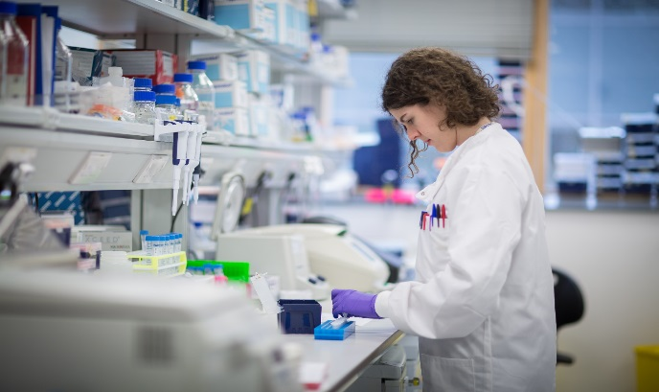
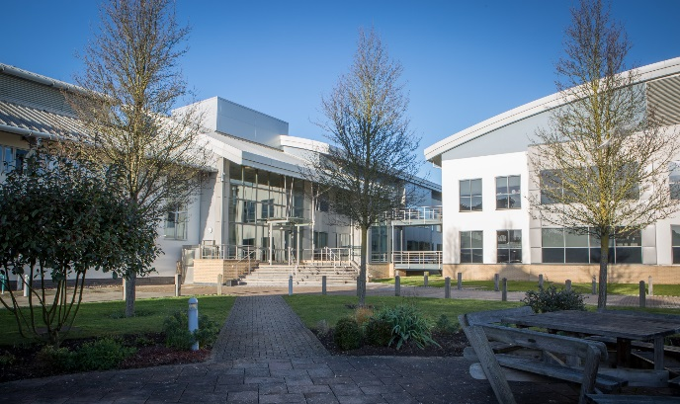
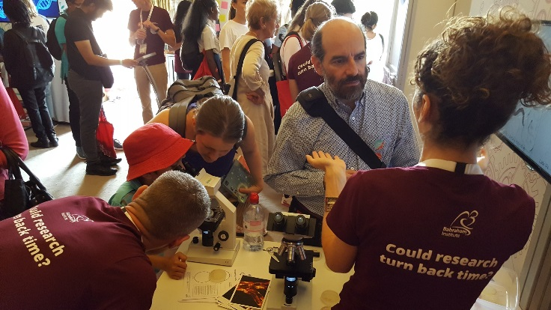

Ageing in C. Elegans
@babrahaminst

Slide 2
Learning Outcomes
All students will: | Be able to explain why worms could be a useful mode organism for understanding ageing.
Most students will: | Provide an example of how lifestyle factors can affect how we age.
Some students will: | Describe the process of addressing a scientific problem through weighing up the advantages and disadvantages of different model organisms.
Key word/s | Worms, ageing, model organism, diet, healthspan, lifespan

Slide 3


Starter: What happens when we age?
What are some features of ageing?
Wrinkled skin | Spine curvature
Muscle wastage | Increased risk of infection
Cataracts | Sleeping problems
Alzheimer’s | Frailty
Notes:
See fact sheet for more information
CC images:
Dog w/ cataracts: https://www.flickr.com/photos/carbonnyc/6252864832
Old person: https://www.pexels.com/photo/adult-elder-elderly-enjoyment-432722/

Slide 4
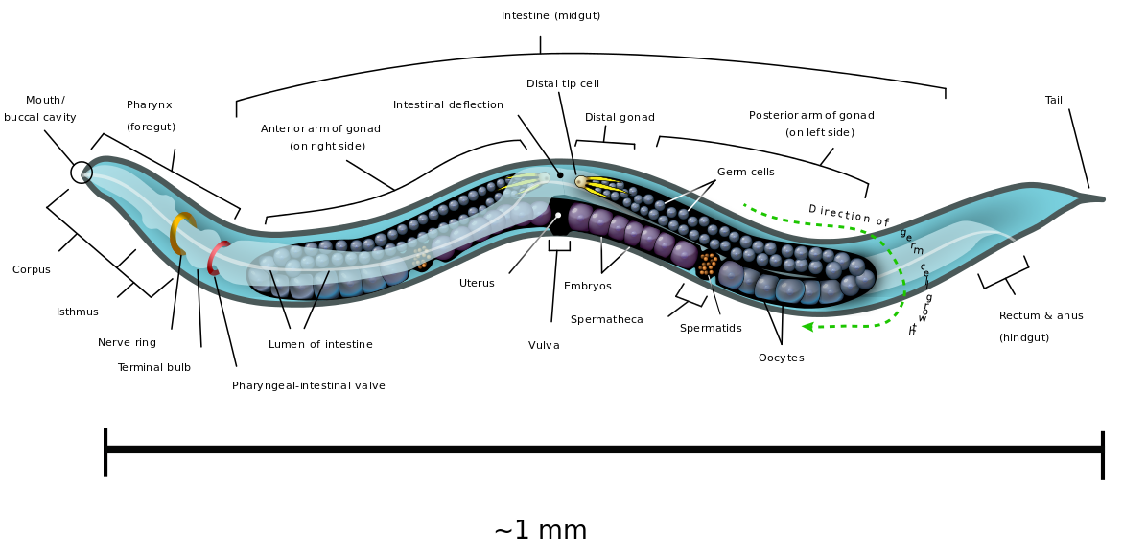
What are C. elegans?
Mostly hermaphrodites
Lay eggs and can produce 200-300 offspring
Lifespan is 2-3 weeks
1-2 mm nematode worms
Eat bacteria
Present across the globe
Notes:
See fact sheet for more information
CC images
C.Elegans diagram - https://en.wikipedia.org/wiki/File:Caenorhabditis_elegans_hermaphrodite_adult-en.svg

Slide 5
Why use C. elegans in research?
Easy to breed and work with
Short lifespan
Producing many offspring/ clones
Well characterised
  Genome fully sequenced (100 million nucleotides)
  959 somatic cells
Notes:
See fact sheet for more information

Slide 6
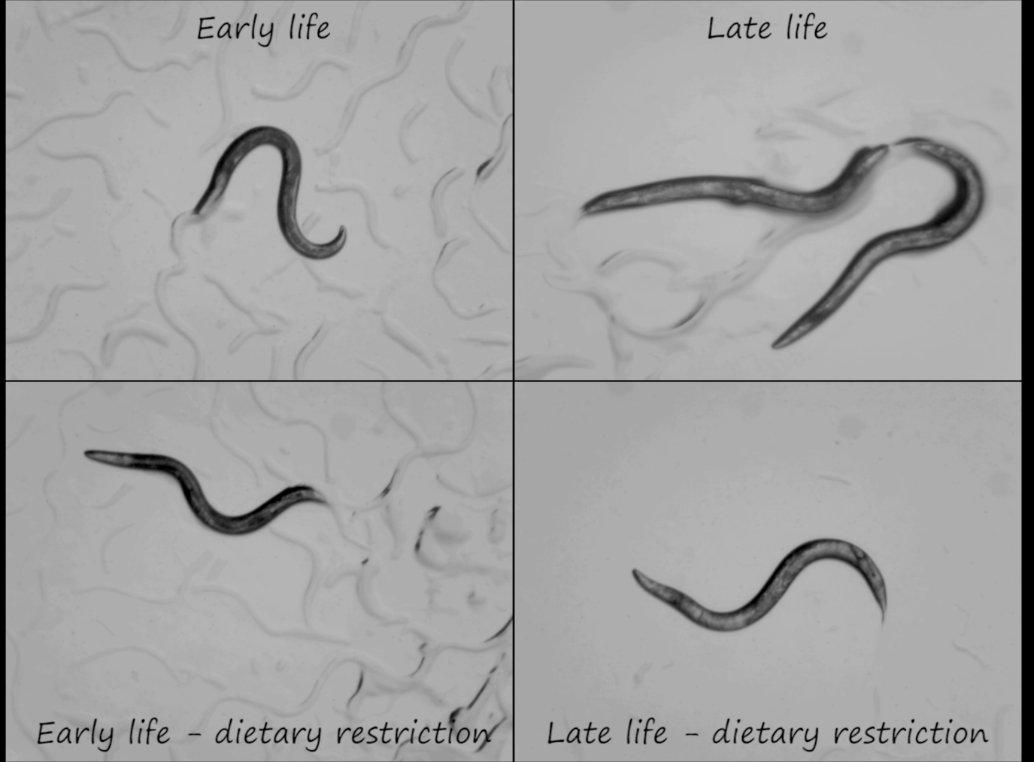
Principle activity: spot the differences
What differences do you see?
Notes:
Activity – click on hyperlink on video/text to be shown a video of worms
What are the differences you see between young and older worms? And how does a dietary restriction influences this ageing process? (backup video link: https://www.youtube.com/watch?v=QbdHIW8xNKA&feature=youtu.be)
See fact sheet for more information

Slide 7
Answers
Young vs Old
Decrease of speed
Increase of transparency
Intestines start to look damaged and become thinner
A straighter body posture
Less bodily movement, only their heads and tails
Notes:
See fact sheet for more information

Slide 8
Answers
Normal vs restricted diet
No noticeable difference at early life
The late life worms on a dietary restriction seems less old compared to those with normal food availability
A restricted diet slows down the ageing process in C. Elegans worms.
Importantly, this does not mean that the same will happen in humans, we need to study this further!
Notes:
See fact sheet for more information
Researchers hope to understand the mechanisms of this process and in the future be able to slow down the ageing process in humans as well, without them having to restrict a large percentage of their diets.

Slide 9
Recap
What makes c.elegans a good model organism?
What are the disadvantages?
What would a human experience if they had 30% of their diet? (600 calories a day)
Notes:
Advantages:
Small
Short lifespan
Rapid reproduction
Hermaphrodites which means they are clones of the adult worms
Disadvantages:
Evolutionarily not very close to humans, so can only look at basic things and can’t extrapolate too much into humans

Slide 10
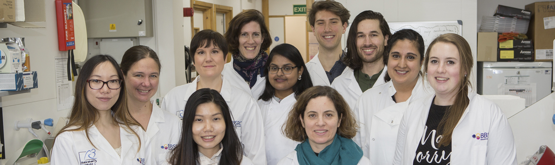
More information BI worm research
The Casanueva group at the Babraham Institute uses C. Elegans as a model for their research.
More information can be found here: https://www.babraham.ac.uk/our-research/epigenetics/olivia-casanueva

