Slide 1
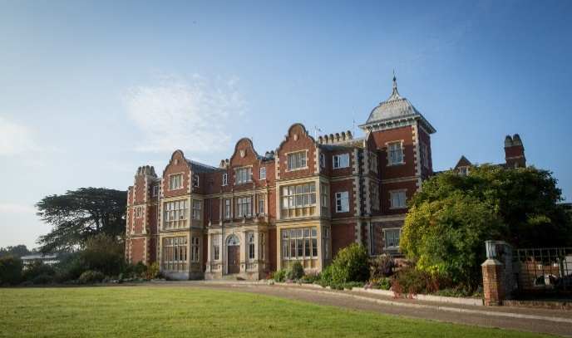
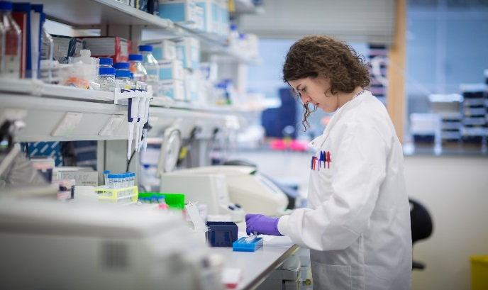
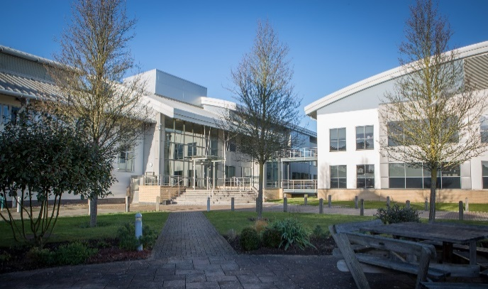
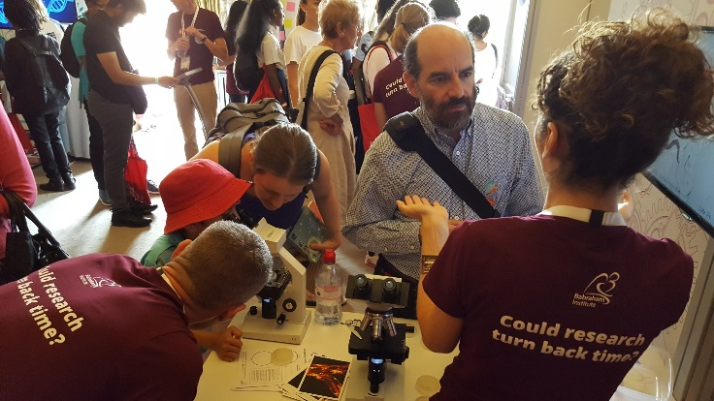
Ethics of the Use of Animals in Scientific Research: Model Organisms
@babrahaminst

Slide 2
Learning Outcomes
All students will: | Give examples of how animals have been used in scientific research
Most students will: | Describe the 3R’s of animal research
Some students will: | Compare the advantages and disadvantages of different model organisms
Key words: | Cell culture; model organism; reduction, replacement and refinement; transgenic

Slide 3
What are your opinions on the use of animals in research?
I can accept the use of animals in scientific research as long as it is for medical research purposes and there is no alternative
Data from: https://www.ipsos.com/en-uk/public-attitudes-animal-research-2018

Slide 4
What are your opinions on the use of animals in research?
There needs to be more work done into alternatives to using animals in scientific research
Data from: https://www.ipsos.com/en-uk/public-attitudes-animal-research-2018

Slide 5
What has already been done – and when?
1915: blood transfusion
1922: insulin isolated (diabetes)
1937: heparin (blood clot prevention)
1940: penicillin
1958: cardiac pacemakers
1967: heart transplants
1977: smallpox eradicated
1987: AZT (HIV treatment)
1996: cloning
2002: genome sequencing
2012: CRISPR (genome editing)
2021: COVID-19 RNA vaccine
Source: http://www.understandinganimalresearch.org.uk/why/health-timeline/

Slide 6
Why do we use animals in research?
People are the best research model but animals are the next best because at the cellular level many animals are alike.
Which animals are used?

Slide 7
Activity: different models for research
Arrange the cards for the eight different models:
By how similar they are to humans
By how easy it is to use and understand
By how much welfare is a concern

Slide 8
What makes some models better than others?
‘Simple’ model animals that are easier to keep and have less complex biology are less relevant to humans
Alternatives such as simpler organisms, cell culture and computer modelling are often quicker and cheaper than animal research, but these are simplified models
A few animal studies are still needed to confirm what the results mean in mammals

Slide 9
The 3Rs in animal research
Replacement
Could any of the work be done in tissue culture or using computers? If no, could the work be done in ‘lower’ species such as flies or worms?
Refinement
Improve animal welfare and reduce any potential suffering. Don’t keep using long-established procedures without thought.
Reduction
Minimise number of animals used in each experiment.
Notes:
The 3Rs were introduced during the 1950’s – but what are they? https://www.nc3rs.org.uk/the-3rs

Slide 10
Exploring the 3Rs
In pairs, discuss each of the real-life examples and determine whether each is reduction, refinement or replacement of animal research.

Slide 11
Plenary
Scientists use animals in research when they cannot attain their results any other way. There are a huge number of medical treatments available thanks to animal research.
Medical development could be continued without harming animals. The differences between humans and other animals mean that scientists cannot meaningfully translate the research.
Which do you agree with more? What do you find acceptable?

Slide 12
Plenary
Research using animals has led to significant medical advances.
All vertebrate animals used in research in the UK are protected by strict rules, including the 3R principles.
All model organisms and alternatives have advantages and disadvantages and different uses.
Different people have different opinions on the use of animals in research.

