Slide 1

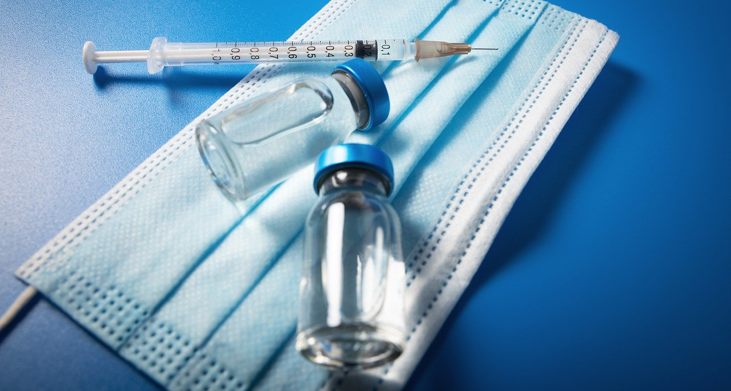


Viruses and Vaccinations
Notes:
Image by Ronstik from Pixabay. Available at <https://pixabay.com/users/ronstik-8349963> [Accessed 1/10/2021]. Pixabay license.

Slide 2
How this lesson is going to work…
Some history
A measles simulation
Some important basics
The difference a vaccine can make
Time to play!

Slide 3
Learning outcomes
All will be able to: Describe how a vaccine works
Most will be able to: Define antigen, antibody and pathogen
Some will be able to: Use named examples and describe what properties have the biggest impacts on controlling disease

Slide 4
Raise your hand if you’ve ever had a vaccine

Slide 5
What vaccine was it?

Slide 6
Some history about vaccines…How were they discovered?
The Origin of Vaccines - YouTube
Notes:
Openmind, 2016. The origin of vaccines. [video] Available at: <https://www.youtube.com/watch?v=E_PKQ_M7AtU> [Accessed 15 March 2021].

Slide 7
Measles simulation
50% vaccination
VirusFighter
Notes:
Run without changing any properties, except vaccination rate at 50%, for 30 days

Slide 8
What did you notice?

Slide 9
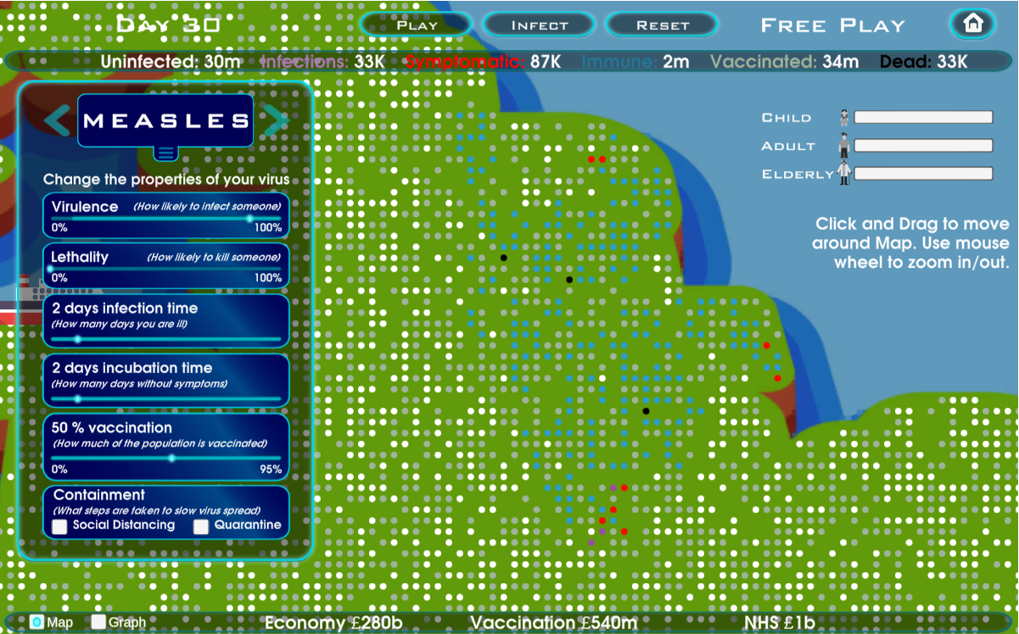

Slide 10
3 important words
Pathogen- germs that cause disease (bacteria, fungus, parasite, virus)
Antigen- Part of a pathogen which the body can recognise triggering your immune system to respond by creating antibodies
Antibody- Part of your immune system and are your ‘first defence’ used to fight off pathogens

Slide 11
Pathogens
What are they?
What do they do?
What Are Pathogens? | FuseSchool - YouTube
Notes:
Fuse school, 2016. What are pathogens?. [video] Available at: <https://www.youtube.com/watch?v=WsZS4RCWpcE> [Accessed 15 March 2021].

Slide 12

Antigens
pathogen
Antigens are part of a pathogen’s membrane and are unique in shape to different pathogens
antigen
Notes:
Image by Enrique Meseguer from Pixabay. Available at <https://pixabay.com/users/darksouls1-2189876> [Accessed 18/10/2021]. Pixabay license.

Slide 13
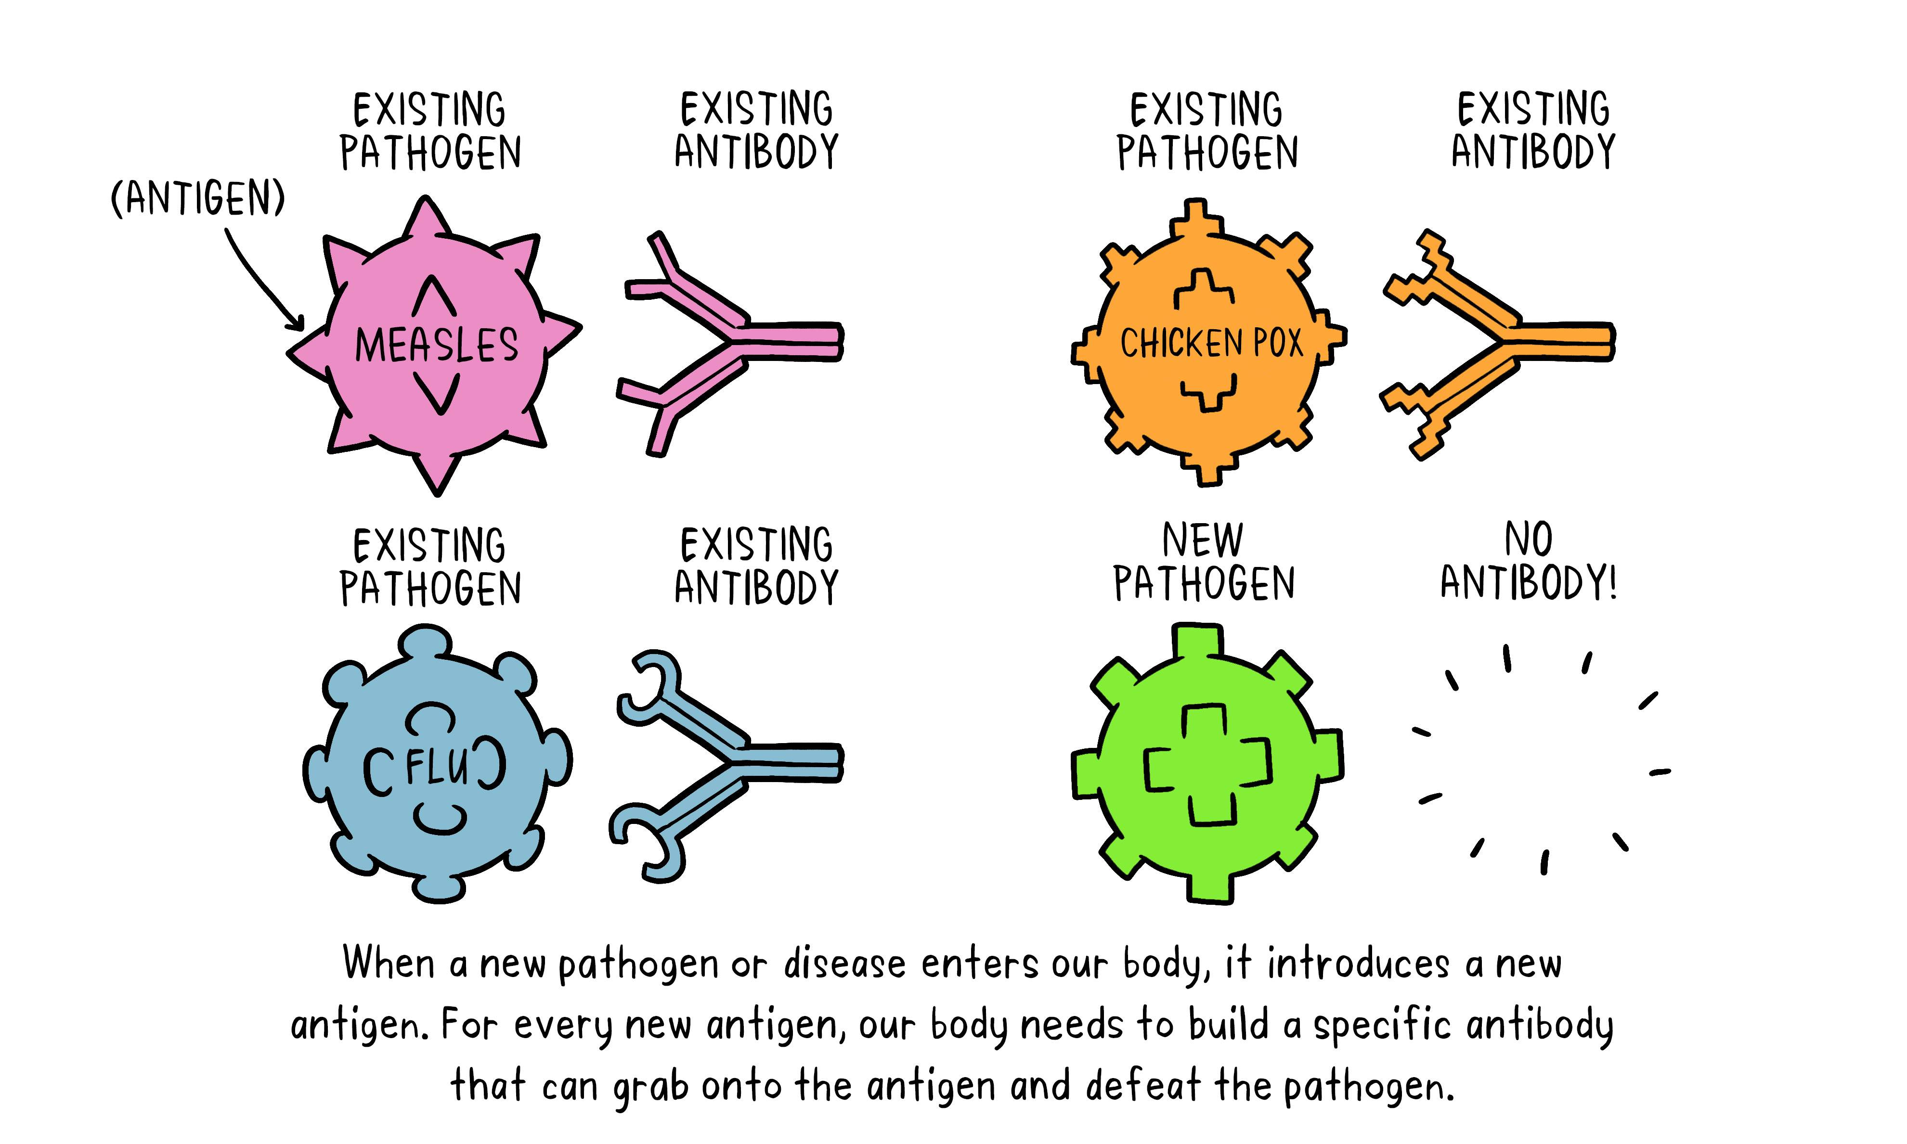
Antibody
The immune system develops antibodies in response to a pathogen, the antibodies attach to the pathogen and destroy it
Notes:
How do vaccines work? Online image: World Health Organization; 2020. Available at: <https://www.who.int/news-room/feature-stories/detail/how-do-vaccines-work> [Accessed 15 March 2021]. Licence: CC BY-NC-SA 3.0 IGO

Slide 14
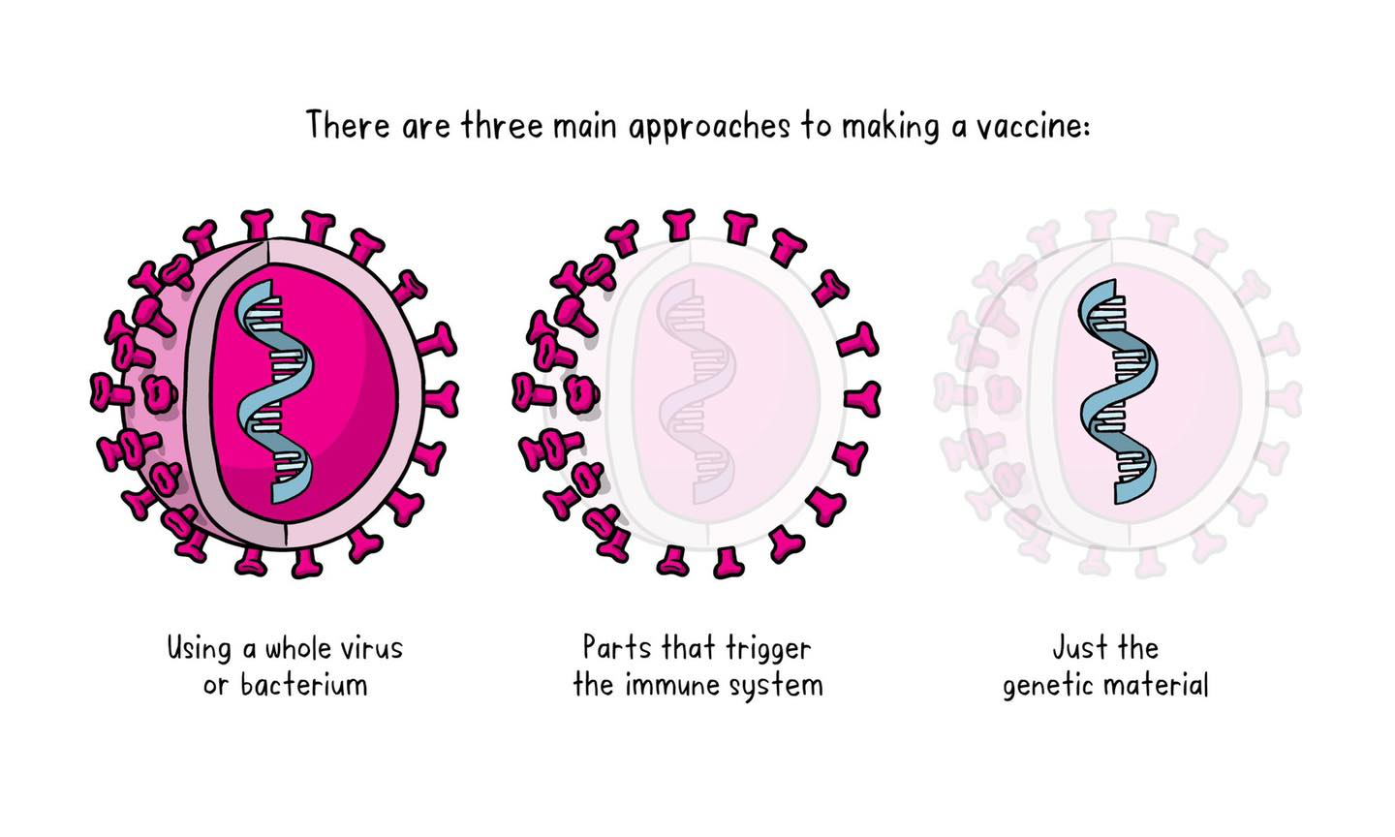
Notes:
Three main approaches to making a vaccine. [Online image]. World Health Organization; 2020. Available at: <https://www.who.int/news-room/feature-stories/detail/the-race-for-a-covid-19-vaccine-explained> [Accessed 15 March 2021]. Licence: CC BY-NC-SA 3.0 IGO

Slide 15
Vaccines
What is a vaccine?
What does it do?
Vaccines 101: How vaccines work - YouTube
Notes:
Nature, 2020. How vaccines work. [video] Available at: <https://www.youtube.com/watch?v=4SKmAlQtAj8> [Accessed 15 March 2021].

Slide 16
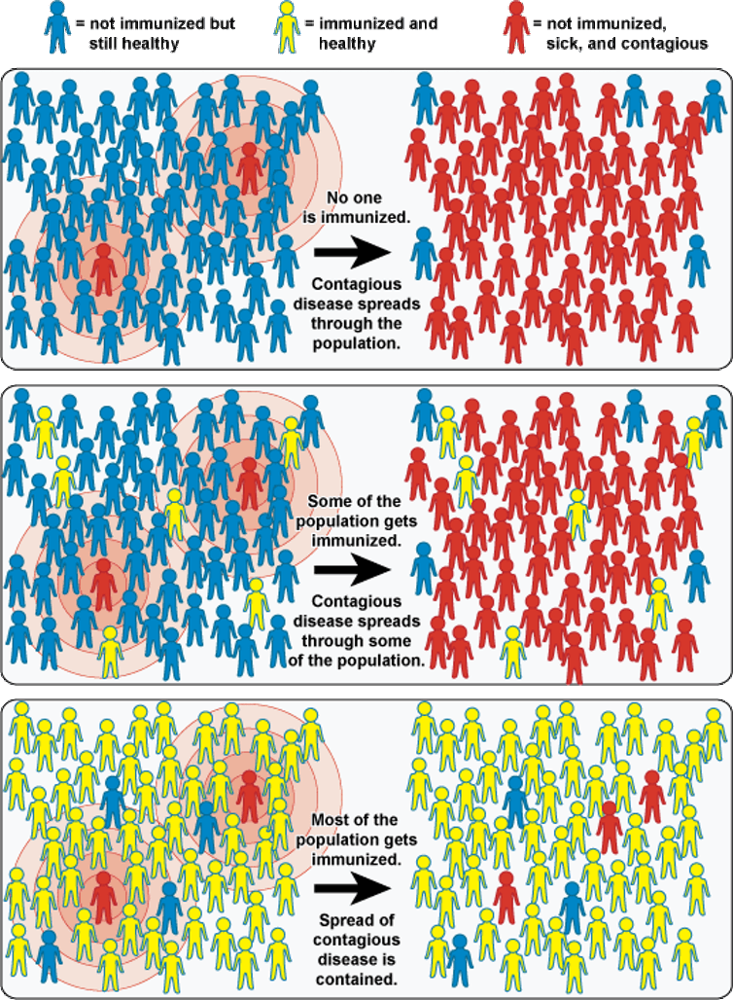
Herd immunity
Notes:
NIAID, 2010. Community Immunity (“Herd” immunity). [Online image] Available at: <https://www.flickr.com/photos/niaid/5149339976> [Accessed 17 March 2021]. License: CC BY 2.0

Slide 17
Let’s take another look at the measles simulation. What is the effect of increasing the number of vaccinated people to 75%?
VirusFighter
Notes:
Run simulation for 20 days at 90% vaccinated
Ask students for predictions

Slide 18
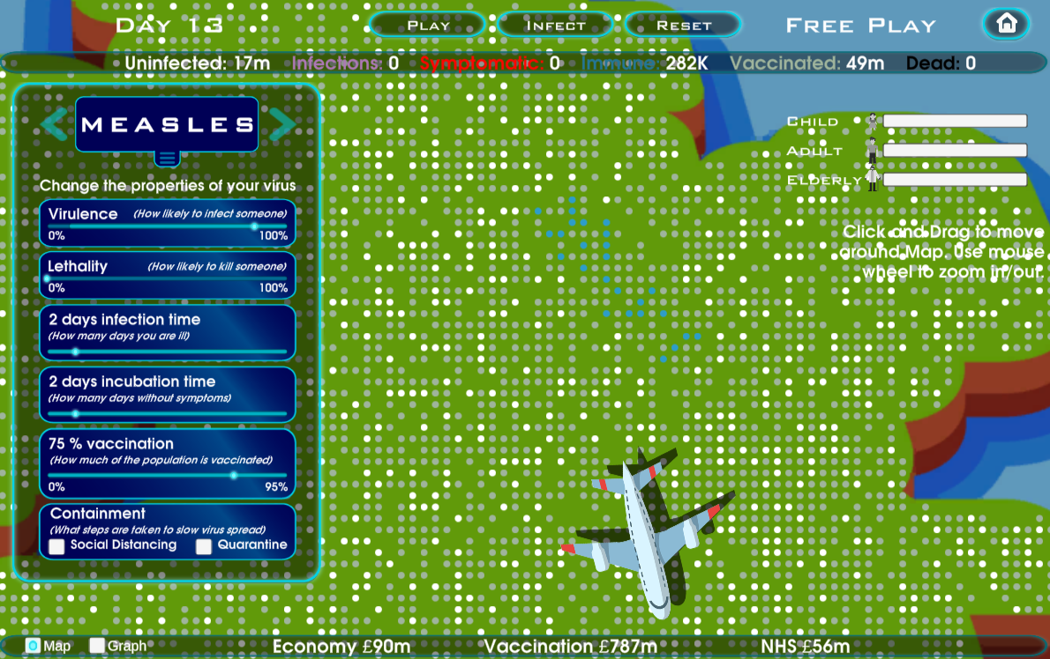
Notes:
Most of the time, the simulation should end before you get to 30 days. Herd immunity has been achieved due to the high vaccine take up.

Slide 19
Spot the difference!
Notes:
In the latter simulation:
-Fewer total infections (those in the ‘immune’ category who have had the disease and recovered)
-Fewer deaths
-Overall, much lower total costs
-Simulation ends of it’s own accord because the infection dies out

Slide 20
Now time for you to play the game!
What virus will you choose?
First, let it run without changing properties.
Now, change one property at a time and compare: which property was most important and what was the cost? What % vaccination is required for herd immunity, and how does this relate to the virus properties?
VirusFighter

Slide 21
Homework
Make a public health poster for a chosen virus and the importance of getting a vaccine to protect against it
OR make a poster on how vaccines work
Notes:
[Optional]

