Slide 1

Epigenetics
Notes:
Confidence in numbers - maybe multiple choice *

Slide 2

‘Epi’ – ‘genetics’
‘Epi’: On top of
Definition:
The study of changes in organisms caused by modification of gene expression rather than alteration of the genetic code itself.

Slide 3

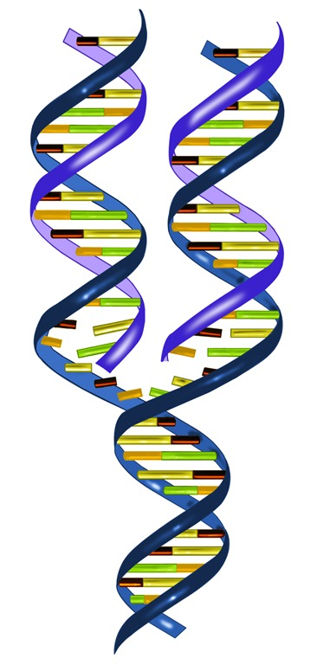
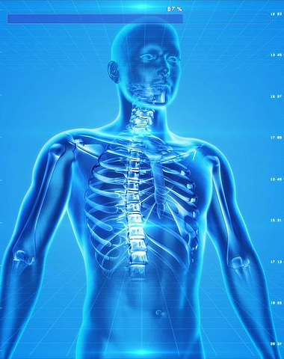
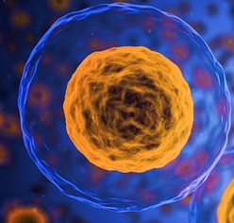
DNA
How many cell types are in the human body?
50 Trillion cells, 200 different types
But all have the SAME DNA.
Notes:
50 trillion cells in your body ~ 200 types – all originate from one cell.
Gene regulation is extreamely important.
When and how these genes are expressed, known as its expression pattern,, is extremely important for Cell differentiation during development
Its what allows us to go from 1 embryonic stem cell/ zygote to 200 different cell types.

Slide 4
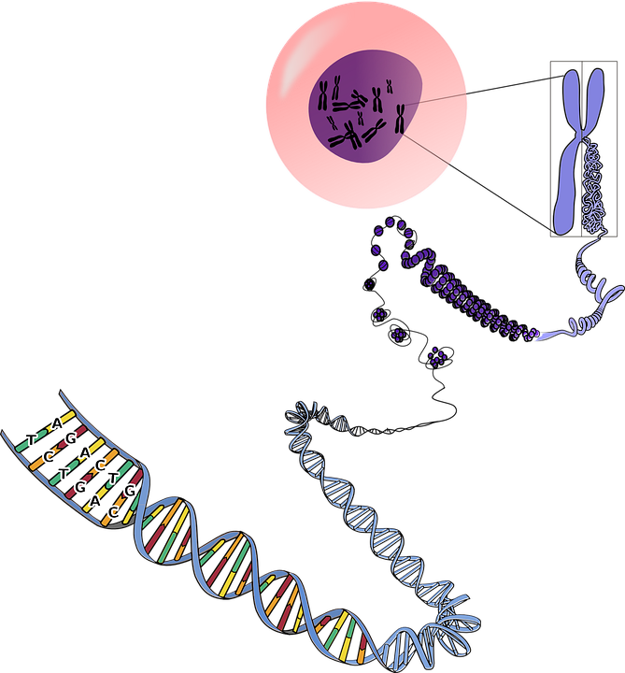
DNA structure within the nucleus
There is about 2 m of DNA in every nucleus in every cell in your body.
To fit in the nucleus it must be tightly wound and compacted.
The DNA wraps around a group of proteins called a nucleosomes, made up of 8 histone proteins.
Histone proteins have ‘tails’ that can be chemically modified in a few different ways, such as methylation and acetylation.
DNA can also be methylated directly on the cytosine base.
All of these modifications are considered epigenetics!

Slide 5




Regulating the gene expression
Imagine your Genome is a library in the nucleus
Each chromosome a separate book of instructions
Epigenetic marks are similar to bookmarks that tell the cell what genes to express or silence.
Gene
Epigenetic mark: Methylation
On
Epigenetic tags can act like a traffic light system, genes can be on, poised or off.
Off

Slide 6
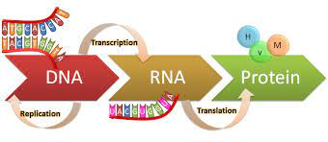
The central dogma
DNA methylation, of its cytosine base, controls how compacted the DNA is, and therefore how accessible to transcription machinery the DNA is.
DNA methylation keeps higher order regulation of which genes can be expressed or silenced.
It is also is used to determine which genes will be inherited from the mother and which from the farther.
This is a process called X-inactivation.
Notes:
2 meters of DNA in each cell of your body!

Slide 7
Epigenetic landscape: Waddington Landscape
Cells differentiate along a pathway and cannot easily go back or change to another pathway. The hills along this pathway that prevent this differentiation change are heavily influenced by epigenetics.
Stem cell
Differentiation
Progenitor cell
Fully differentiated cell

Slide 8
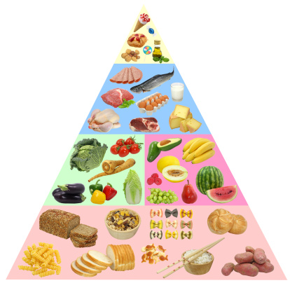


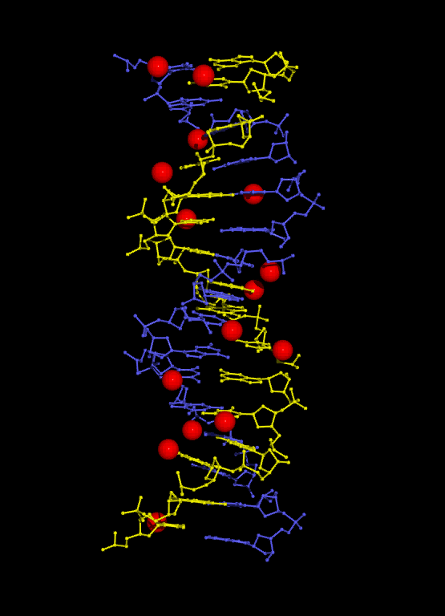



Factors that can cause changes in epigenetics
Names some factors you think may have an affect on your epigenetics
Diet, exercise, pollution, sun exposure, smoking/toxins
and age are the main factors effecting epigenetics
Notes:
heritable

Slide 9
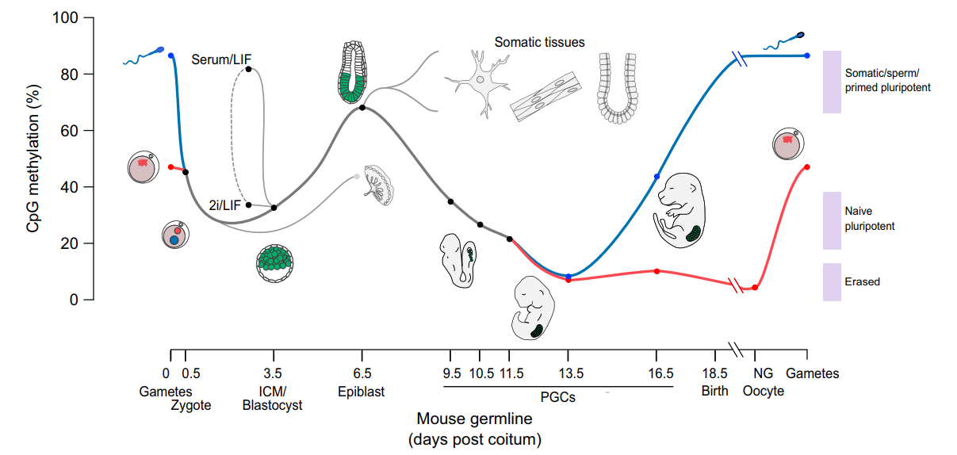
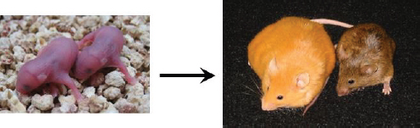
Heritable & imprinting
Early development most epigenetics are de-methylated/ removed
but some specific ones are kept – this is called imprinting.
Epigenetic ‘silencing’ ensures a gene is turned off. This is extremely important in female mammals to stop them from having twice as many X-chromosome gene products as males.
Diet affecting epigenetics example:
Agouti mice – studied the imprinting of genes for hair colour and obesity. Both of these mice are from the same mother but are fed different diets. When put on the same diet the appearance of the mouse on the left will change to that of the mouse on the right.

Slide 10
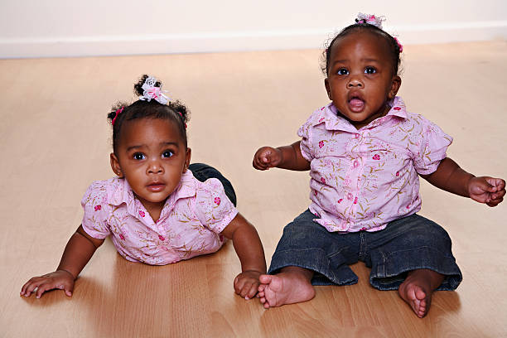


Age effecting epigenetics: Identical twins
Epigenetics are very similar, almost identical in identical twins
But as people get older the factors they are exposed to are different

Slide 11



Age
Causing changes to their Epigenetics.
These changes lead to physical differences that can be more easily studied using identical twins.

Slide 12
The study of epigenetics
Epigenetics has a major influence over diseases such as cancer.
Therefore we need to study epigenetics to understand what is changing and how, to improve healthy ageing.
This information can then be used to create therapies and even help early detection of disease.
Why don’t you help out the scientists by joining our team at The Babraham Institute, in the lab and helping us discover more about epigenetics?
(INSERT ESCAPE ROOM LINK)

Slide 13
Further discussion:
Disease and epigenetics:
The first disease to be linked to epigenetics was cancer in 1983.
Another linked disease is Fragile X syndrome which affects 1 in 4,000 males and 1 in 8,000 females.
Why do you think males are more affected than females in this disease?
Epigenetics in treatments:
Therapies for epigenetics are preferable as they do not require changing the DNA. Chemicals can be used to naturally silence genes by methylating them or preventing/removing methylation.
Caution should be used when using epigenetic therapies. Why do you think this is?

