Slide 1


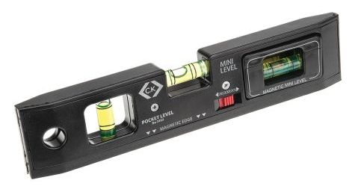


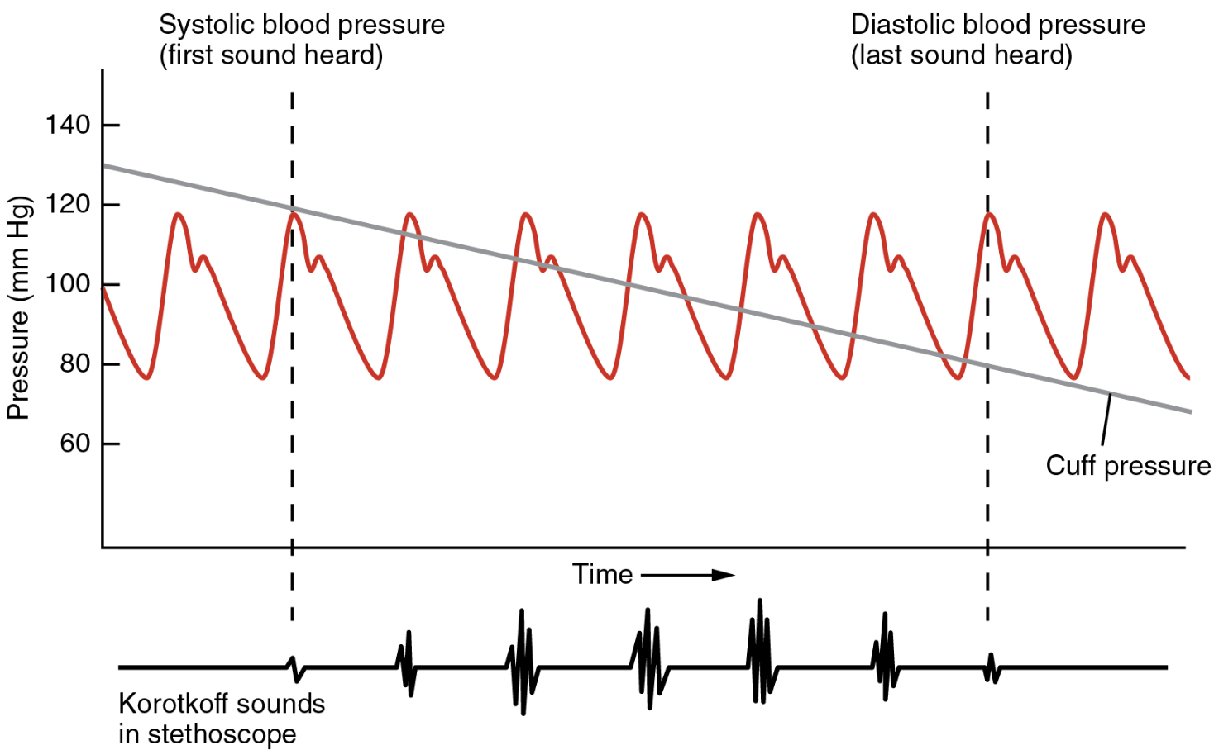


This title is in 80 point bold Calibri
Author names in 54 point regular Calibri
Introduction
Logo files
Fonts
This page has been set up as a template to assist students with creating posters for our sixth-form conference. The page size is approximately A1 – 84 cm x 59 cm. You may wish to allow a margin around the edge of your poster.
Use ‘Format Shape’ to ensure that your text boxes are the same width as much as possible - these are all 18 cm. Use the align and distribute tools (on the Arrange button) to ensure that all of the elements of your poster are aligned and/or distributed properly.
Be careful when using web images (including your school logo) as they may be blurred when enlarged. A suggested resolution is 300 dpi.
Be careful with white space around graphics and their height-to-width ratio. Only use royalty free images or those you have permission to use.
The title text is 80 point bold, with the authors in 54 point regular. The section headings are 44 point.
All text should be no smaller than 20 point – and ideally at least 32 point (like this sample text).
You have a wide choice of font families to use but…
Make sure it is easy to read. Anything too fussy starts to detract from the information you are trying to convey.
Try not to use more than two different fonts in a poster.
You can use a second typeface to create contrast and interest but keep it simple – serif fonts can be harder to read.
Insert, Copy and Paste
Colours
And finally…
If you embed objects from other programs such as Word you may have to open that program each time you want to edit the text. It can also make the file size bigger.
To copy and paste from Word, select the text in Word, and open a new text box in PowerPoint before pasting the text. This will ensure that it is a PowerPoint object. Export graph files as images rather than embedding them.
Choose your colours carefully - remember they may look different on different screens. Ensure a good contrast between text or images and the background. Below is the standard Microsoft Office colour wheel.
Check your poster carefully before you submit it. It is always a good idea to get someone else to check your poster as they will often pick up errors you have overlooked.
Please save as a pdf with your name and school name in the title and submit it to PE@babraham.ac.uk by 5.00pm on Thursday 19th November.
Your school may have its own standard colour scheme – check with your teacher.
Notes:
1

